Slide 1


Anti Doping
Season 2023-2024 Information Booklet

Slide 2
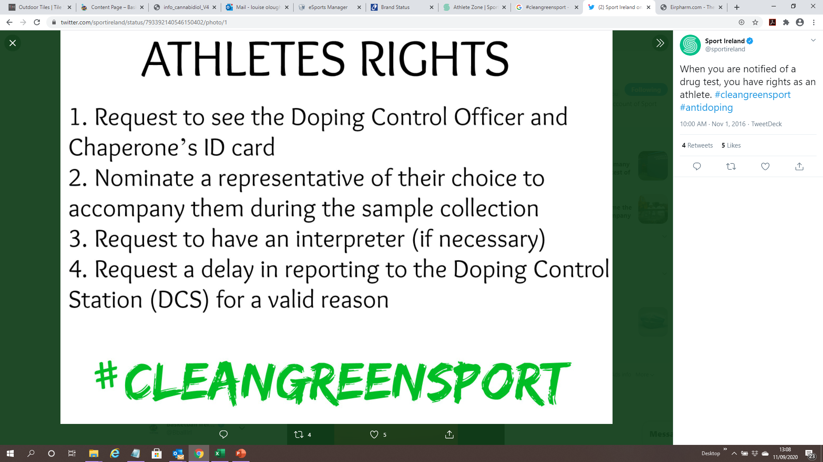
What is Anti Doping?
'Doping' refers to an athlete's use of prohibited drugs or methods to improve training and sporting results.
Sport Ireland’s National Anti-Doping Programme acts to protect Ireland's sporting integrity against the threat of doping.
Basketball Ireland has adopted the Sport Ireland and World Anti Doping Agency (WADA) position that cheating, including doping, in sport is fundamentally contrary to the spirit of sport, undermining the otherwise positive impact of sport on society.
Download the Clean Sport Commitment Statement in the Anti Doping Section on the Basketball Ireland Website.
All club personnel have a responsibility to ensure that club members are aware of the Irish Anti-Doping Rules and that there is an atmosphere supporting a drug free sport within the club.
The consequences of not adhering to Anti-Doping rules can be severe for athletes and their support personnel such as coaches and parents.
Notes:
https://www.youtube.com/watch?v=ig01z_vxQGA

Slide 3

Irish Anti-Doping Rules
Under the Irish Anti-Doping Rules, Sport Ireland carries out drug testing on behalf of Basketball Ireland. These measures came into effect on January 1st, 2021.
Sport Ireland E-learning Guide - https://www.sportireland.ie/anti-doping-e-learning
Notes:
https://www.youtube.com/watch?v=ig01z_vxQGA

Slide 4
Strict Liability
Players are solely responsible for any prohibited substance found in their body.
Your Body
Your Responsibility
Notes:
https://www.youtube.com/watch?v=ig01z_vxQGA

Slide 5

WORLD ANTI-DOPING AGENCY = WADA
WADA PROHIBITED LIST
“The List of Prohibited Substances and Methods (List) indicates what substances and methods are prohibited in sport and when”
Medications must be checked regularly to ensure they are not prohibited by the World Anti-doping Agency.
Notes:
https://www.youtube.com/watch?v=ig01z_vxQGA

Slide 6
2023 List of Prohibited Substances and Methods (List) which comes into effect on January 1st 2023.
2023 Summary of Modifications which will come into effect on January 1st 2023.
Glucocorticoids and Therapeutic Use Exemptions
These documents are also available on https://www.sportireland.ie/anti-doping-rules
Notes:
https://www.youtube.com/watch?v=ig01z_vxQGA

Slide 7
How to Check your Medications
ALL players must check all of their medications, even if it is a once off anti-biotic or over the counter medicine ‘OTC’.
See links below to check medications
In Republic of Ireland (if medication purchased in ROI) – Check the drugs in sport database on http://www.eirpharm.com/
Medications bought in Northern Ireland, U.K., U.S.A and Canada can be checked on http://www.globaldro.com/
If you are taking a restricted or prohibited substance for medicinal purpose contact me immediately to arrange a TUE (Therapeutic Use Exemption) loloughlin@ireland.basketball
Note: Recreational drugs such as cannabis, cocaine etc. are prohibited and can provide a positive test leading to a minimum of 4 years ban in sport. Recent example via the following link AD Violation Example - Recreational Drugs
Notes:
https://www.youtube.com/watch?v=ig01z_vxQGA

Slide 8
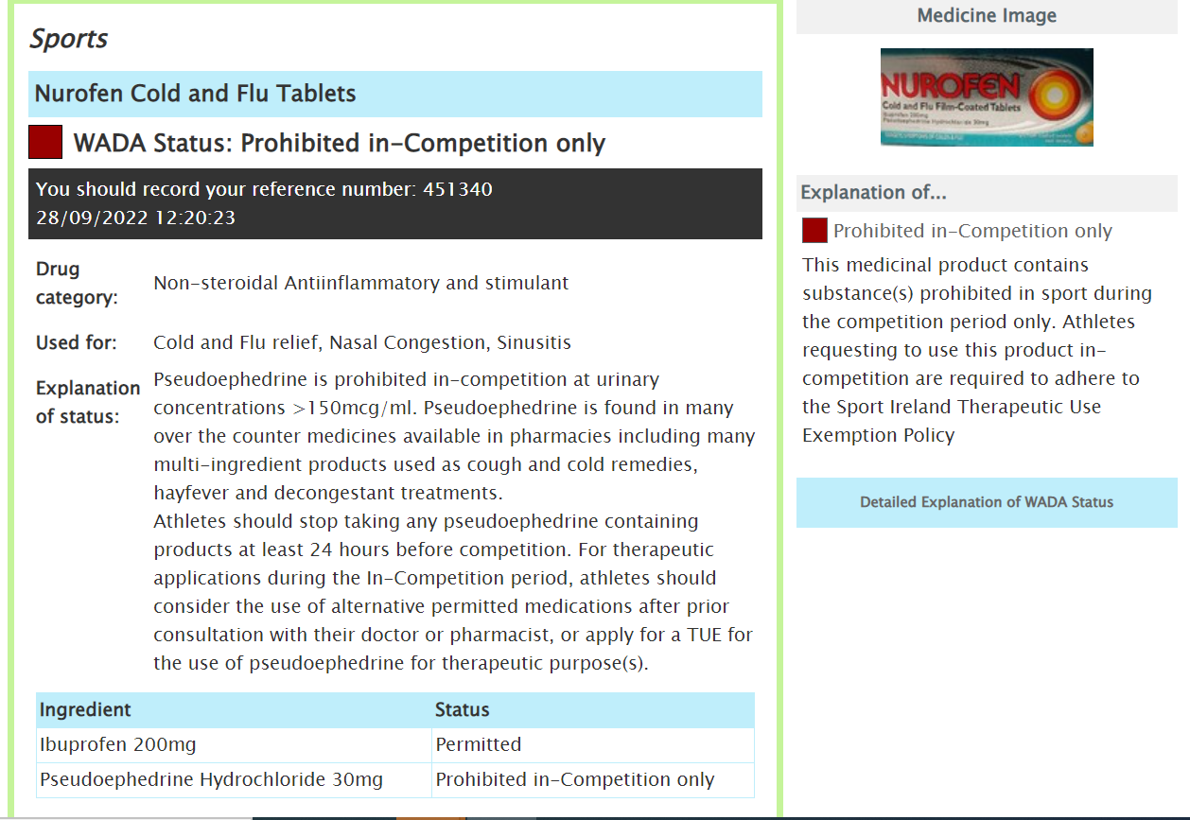
EXAMPLE OF COMMON COLD OTC MEDICINE PROHBITED IN-COMPETITION
IMPORTANT TO CHECK BOTH OVER THE COUNTER AND PRESCRIBED MEDICATION
Notes:
https://www.youtube.com/watch?v=ig01z_vxQGA

Slide 9
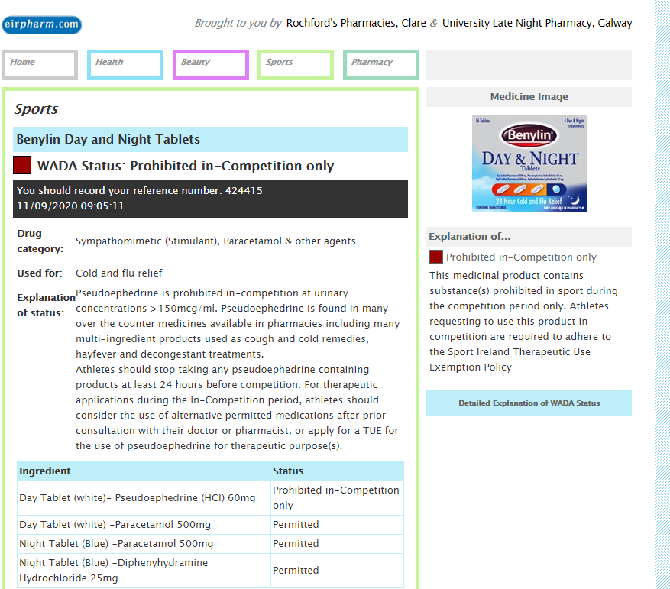
EXAMPLE OF COMMON COLD OTC MEDICINE PROHBITED IN-COMPETITION ….
Check medications regularly.
WADA prohibited List is updated yearly and some items may be added to the list making a product that was previously permitted now prohibited.
Notes:
https://www.youtube.com/watch?v=ig01z_vxQGA

Slide 10
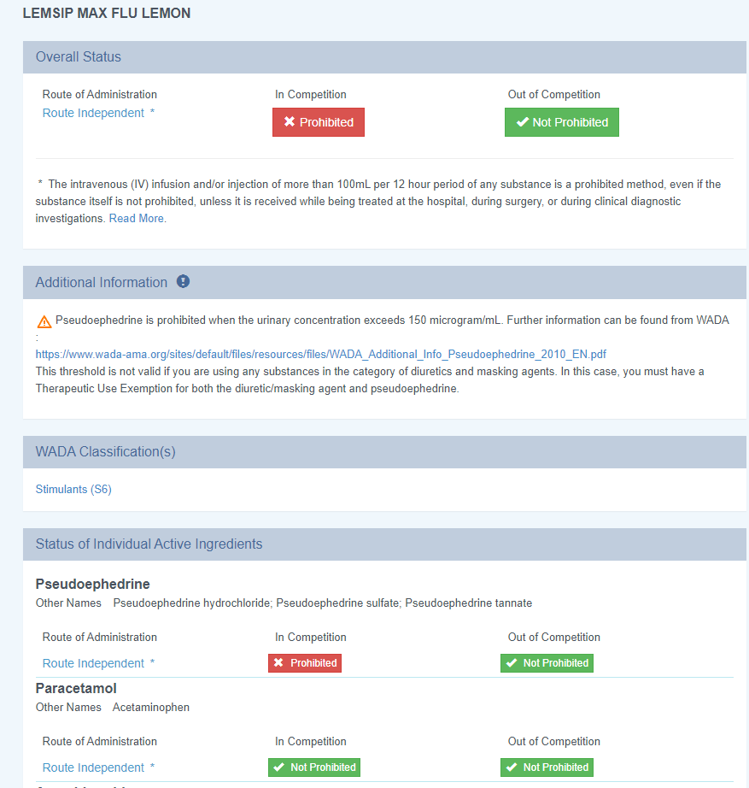
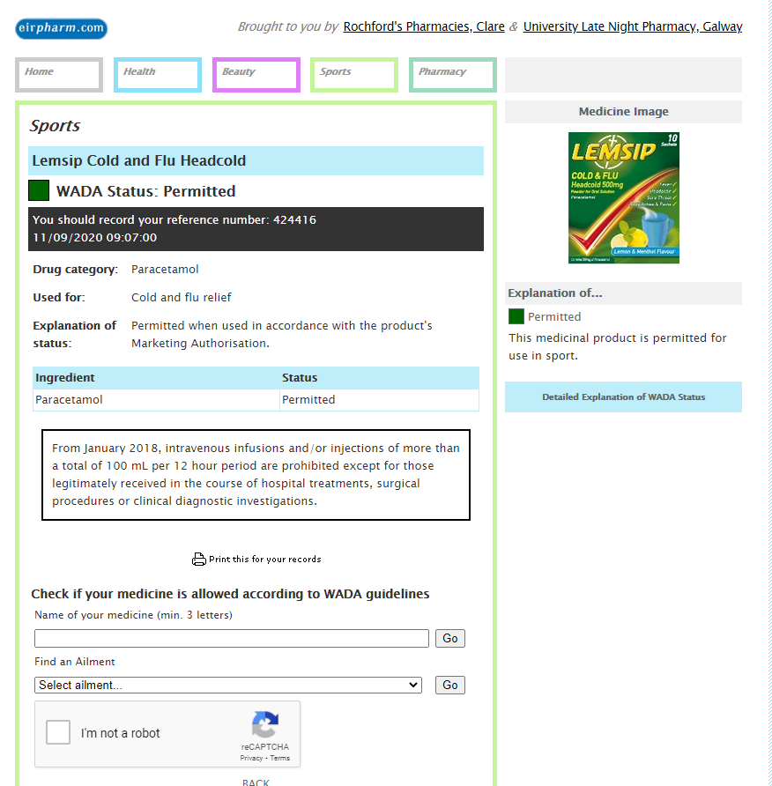
IMPORTANT: USE CORRECT WEBSITE TO CHECK OTC OR PRESCRIPTION MEDICINE
Same product below, one purchased in NI/UK and one on Republic of Ireland (ROI).
UK/NI product is prohibited in competition while ROI one is permitted.
UK/NI product contains Pseudoephedrine which is prohibited in competition.
ALWAYS CHECK MEDICATION IN JURISDICTION IT WAS PURCHASED
Notes:
https://www.youtube.com/watch?v=ig01z_vxQGA

Slide 11
Therapeutic Use Exemptions (TUE)
TUE permits an athlete to use a prohibited substance or method if the substance or method is medically required. Athletes can only get a TUE if there is no unfair advantage from taking the substance or using the method.
Criteria for determining whether a TUE is granted are defined by the World Anti-Doping Agency (WADA).
The athlete would experience a significant impairment to their health without the use of the prohibited substance or method.
The therapeutic use of the prohibited substance or prohibited method would produce no additional enhancement of performance.
There is no reasonable therapeutic alternative to the use of the otherwise prohibited substance or prohibited method.
Athletes may be required to apply for pre-test TUE or they may be eligible for a post-test TUE.
Notes:
https://www.youtube.com/watch?v=ig01z_vxQGA

Slide 12
Basketball Ireland – National League players considered NON-RTP Athletes
A non RTP athlete who is not part of the Registered Testing Pool (RTP) but still competes at National or International level may be subject to doping control / testing in-competition.
Non RTP athletes are eligible to apply for a post-test TUE. Therefore, it is very important to keep up to date medical files and declare all medications on the doping control form.
If an athlete competes internationally at events organised by FIBA a pre-test TUE may be required. Please contact loloughlin@ireland.basketball if you are involved in FIBA events.
Notes:
https://www.youtube.com/watch?v=ig01z_vxQGA

Slide 13
New Testing Method, this does not replace urine samples
Notes:
https://www.youtube.com/watch?v=ig01z_vxQGA

Slide 14
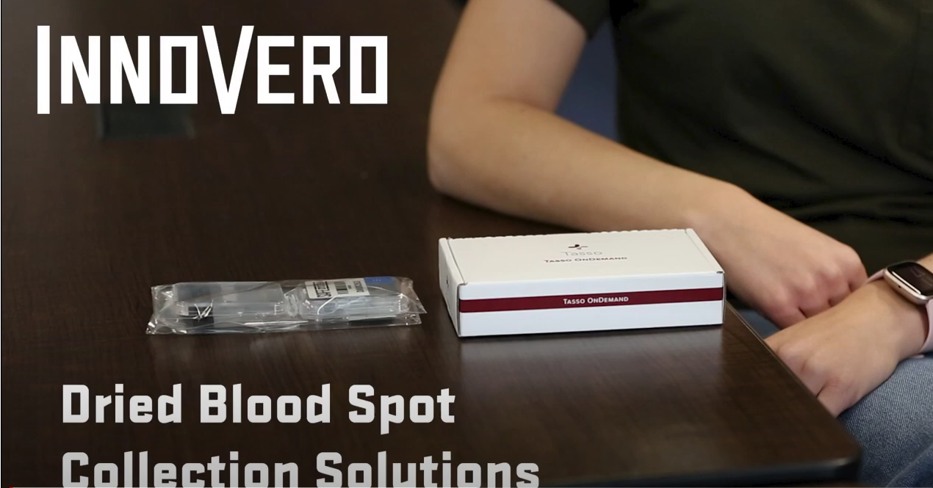
Dried Blood Spots Collection or visit via link https://www.youtube.com/watch?v=OWCuRTCTf3Q
Notes:
https://www.youtube.com/watch?v=ig01z_vxQGA

Slide 15

SUPPLEMENTS
Managing the Risk of Taking Supplements
You MUST undertake thorough internet research of supplement products before it is consumed.
This search should include the name of the product and the ingredients/substances listed.
Information revealed as a result should be further investigated and we advise athletes to keep evidence of their research.
Screen shots should be taken and the results saved in a folder. All saved information should be backed up.
www.informed-sport.com is a risk minimisation tool that can be used to access supplements that have been batch tested.
Assessing the need for Supplement Use
Sports supplements are commonly used by athletes in the hope of maximising the benefits of participating in sport.
Understandably sports people can be confused about the issues around sports supplements. It is important to remember that there are risks associated with supplement use.
Sport Ireland (SI) recommends against the use of sports supplements for the following reasons:
We believe that a correct dietary and nutritional regime will provide all the potential benefits of sports supplements.
We believe that, given the World Anti-Doping Agency (WADA) principle of strict liability, elite athletes are opening up the possibility of inadvertent positive tests by taking supplements.
We believe it is inappropriate for any junior athlete or player to be taking supplements that could have an impact on their physical development.
There are no guarantees that any dietary supplements are safe.
Before taking any dietary supplements please assess the following
The Need: seek nutrition advice from a professional sports dietician
The Risk: If you choose to take a supplement you should assess the associated risks and make an informed decision. Please see risk minimisation guidelines below
The Consequences: consuming a contaminated product may result in a 4 year ban from sport
More information on Sport Ireland Website
https://www.sportireland.ie/anti-doping/athlete-zone/supplements-and-herbal-remedies
Notes:
https://www.youtube.com/watch?v=ig01z_vxQGA

Slide 16
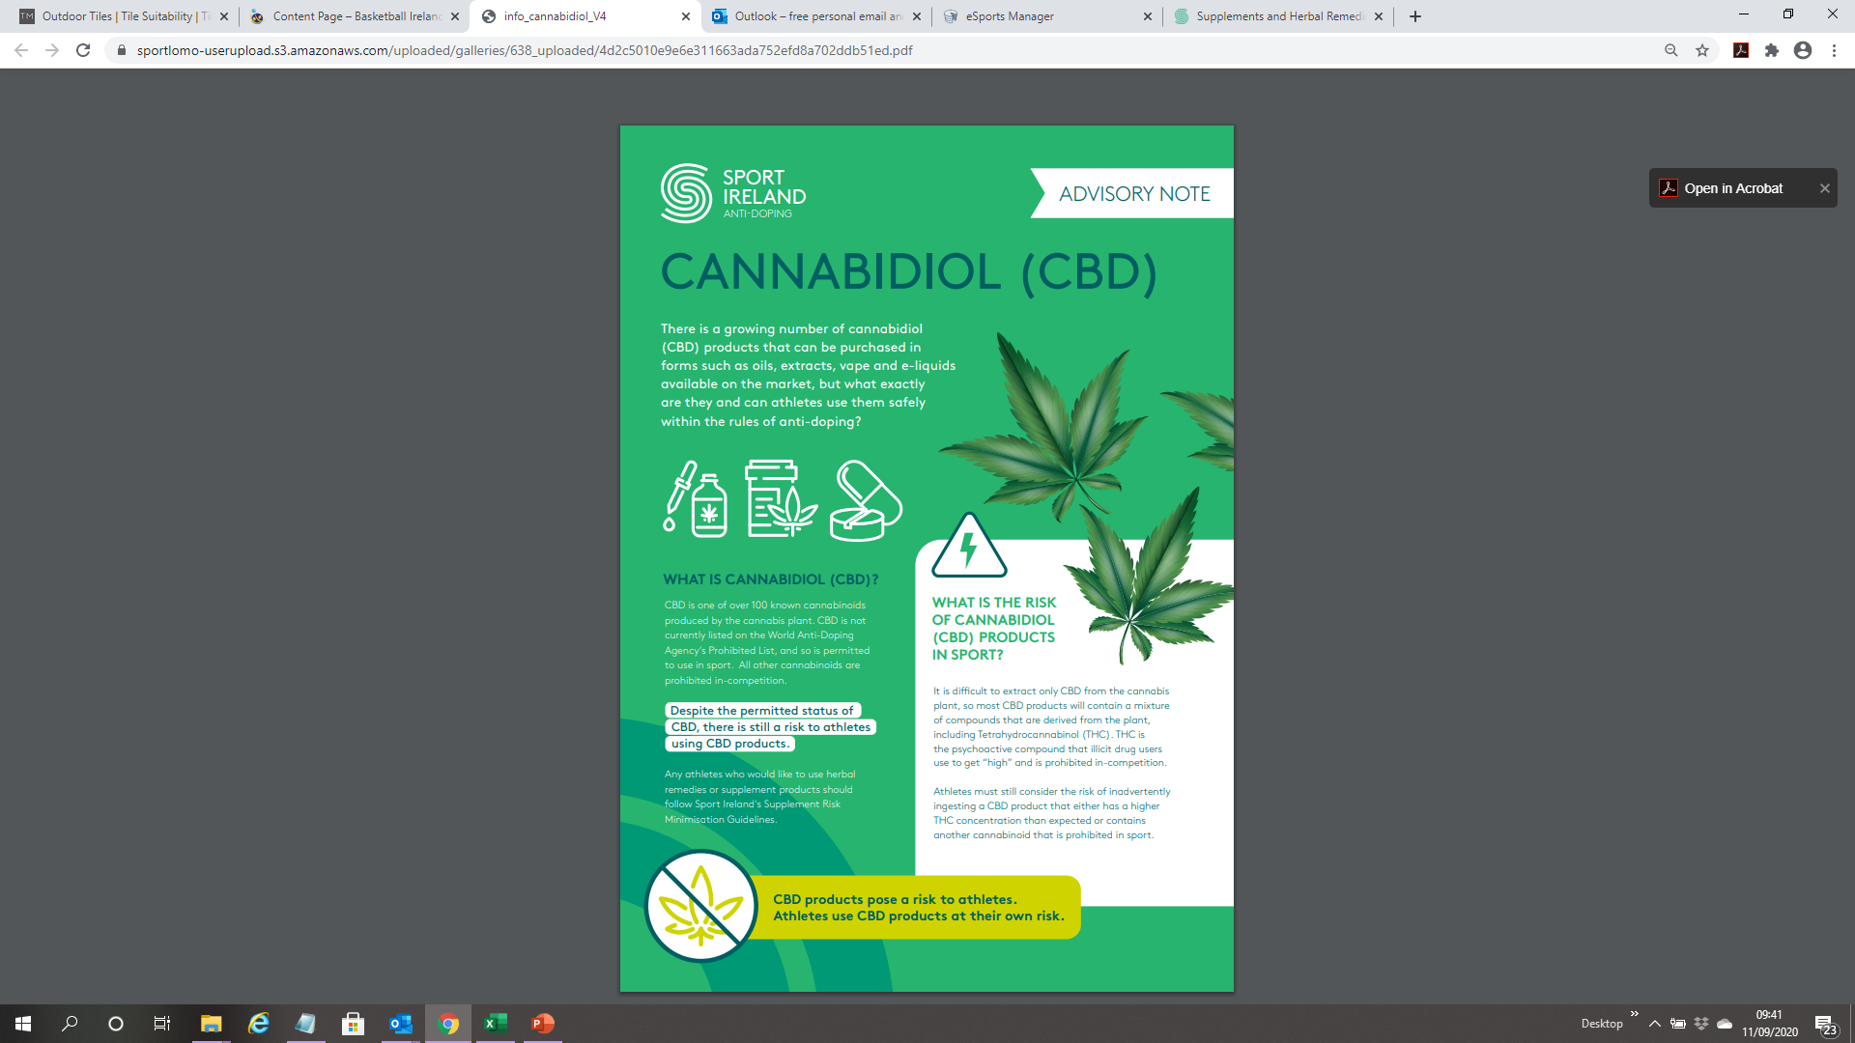
Notes:
https://www.youtube.com/watch?v=ig01z_vxQGA

Slide 17
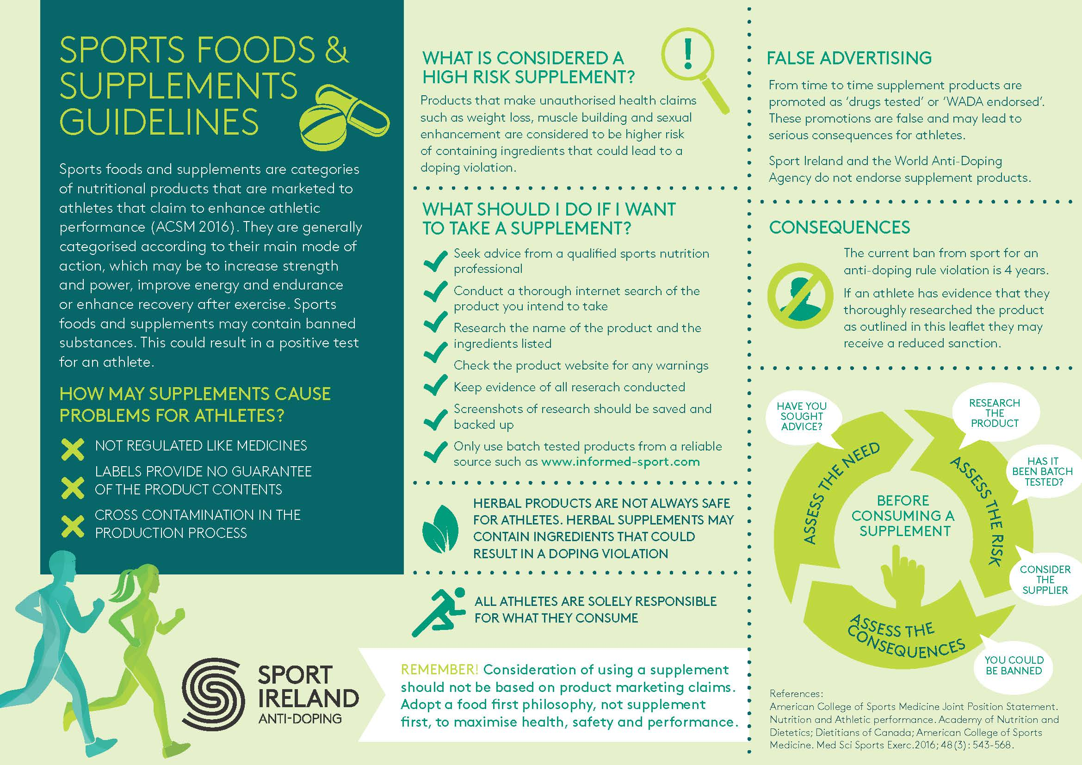
Notes:
https://www.youtube.com/watch?v=ig01z_vxQGA

Slide 18
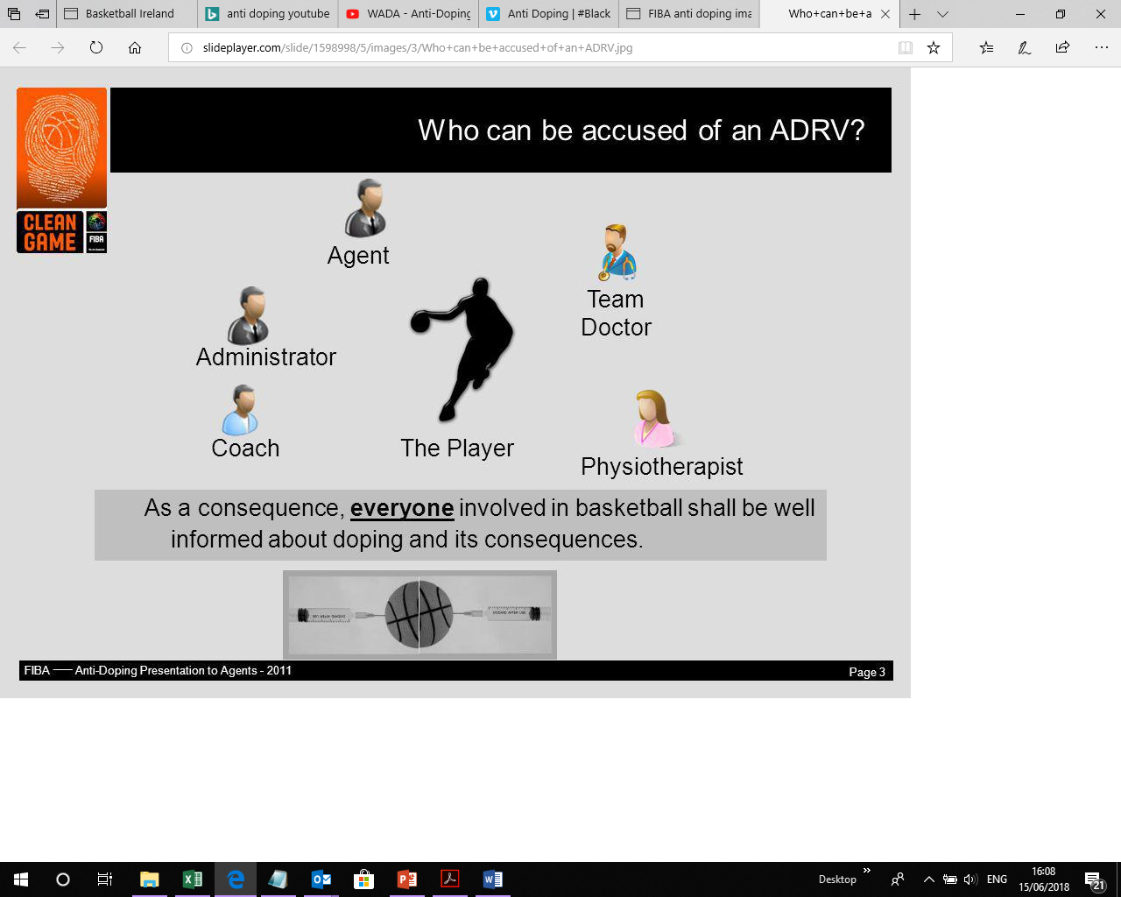
Who can be accused of an Anti-doping Rule Violation / ADRV?
Notes:
https://www.youtube.com/watch?v=ig01z_vxQGA

Slide 19

Sport Ireland provide a range of different educational tools – all accessible via the SI website. Available also on the Basketball Ireland website. Links below.
Sport Ireland Education Zone - https://www.sportireland.ie/anti-doping/education-zone/education-zone
What happens in a drug test - https://www.sportireland.ie/anti-doping/education-zone/education-zone/what-happens-in-a-drug-test
Sport Ireland E-learning – https://www.sportireland.ie/anti-doping-e-learning Key topics covered: Anti-doping rule violations, testing procedures, how to check meds.,TUEs, supplements, consequences of doping.
Basketball Ireland Anti-doping section - https://ireland.basketball/anti-doping
National Anti-doping Organisations - Guiding Principles for the future of Anti-Doping
Notes:
https://www.youtube.com/watch?v=ig01z_vxQGA

Slide 20

Anti Doping Officer
Louise O’Loughlin loloughlin@ireland.basketball
ANY QUESTIONS….
PLEASE FEEL FREE TO CONTACT

